Slide 1
Understanding your personality

Slide 2
Trait Theories
Explain differences between people in terms of stable personality traits
Modern day psychologists have found 5 personality dimensions that span cultures

Slide 3
The 5 Factor Theory
Openness to Experience
Conscientiousness
Extraversion
Agreeableness
Neuroticism

Slide 4
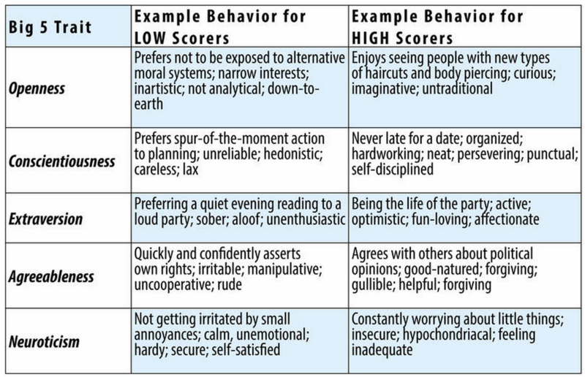

Slide 5
Activity time
Extraversion
Outgoing
Withdrawn
Neuroticism
Stable
Unstable

Slide 6
The 5 Factor Theory
Agreeableness
Low
High
Conscientiousness
Undependable
Dependable

Slide 7
The 5 Factor Theory
Openness to Experience
Closed
Open

Slide 8
The 5 Factor Theory
Helpful in predicting general trends in behavior
Too general to predict behavior in a specific situation

Slide 9
Social Cognitive theory: A modern view of personality
Human behavior is influenced by POSITIVE REINFORCEMENT as well as Cognitive factors.
Bandura
Self –System
Self reinforcement
Self efficacy
Locus of control

Slide 10
Reciprocal Determinism
Environment
Personal
Cognitive
Factors
Behavior

Slide 11
Self-Efficacy
One's perception of personal effectiveness
One of Bandura's personal/cognitive factors

Slide 12
Self-Efficacy
Belief you will do well
Greater effort & persistence
Success

Slide 13
Self-Efficacy
Belief you will do poorly
Less effort & persistence
Failure

Slide 14
Internal Locus
Belief you control your fate
Optimism about the future
Taking action

Slide 15
External Locus
Belief you don’t control your fate
Pessimism about the future
Doing nothing

Slide 16
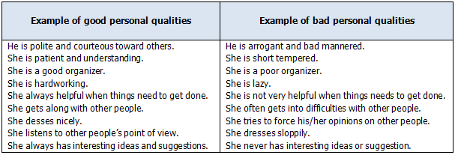

Slide 17
Type A & Type B personality
Do the test - stress and your personality type discuss stress management strategies

Slide 18
THANK YOU !

